Slide 1
Visual Odometry
Finding the position of an object(AR Drone-camera) in an environment by analyzing images captured from it

Slide 2
AIM
The goal is to estimate the position of the drone in an environment by feeding the data we get from the analyzing the images captured by the AR Drone’s onboard camera .
This data is fed into algorithms that help us estimate the position of the drone in the environment and also in optimizing its trajectory.

Slide 3
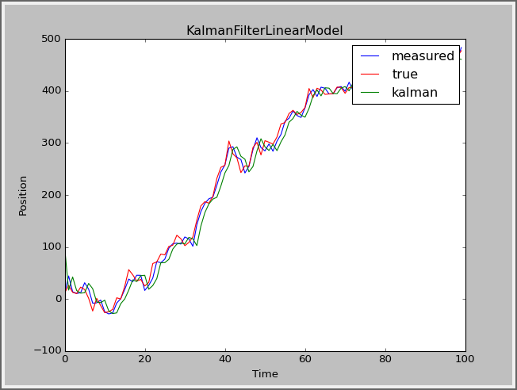
Kalman-Filter
Kalman Filter is an algorithm that uses a series of measurements over time, containing statistical noise and other inaccuracies to produce an estimate of unknown variables that is more accurate than when based off of single measurements

